Slide 1


Logic Circuits
Homework – Exercise 3

Slide 2
Problem Statement
Exercise 1
Draw a logic circuit having 3 input wires and containing all basic and derived gates. Write the corresponding Boolean function, simplify it and then draw a simplified circuit equivalent to the initial one.

Slide 3
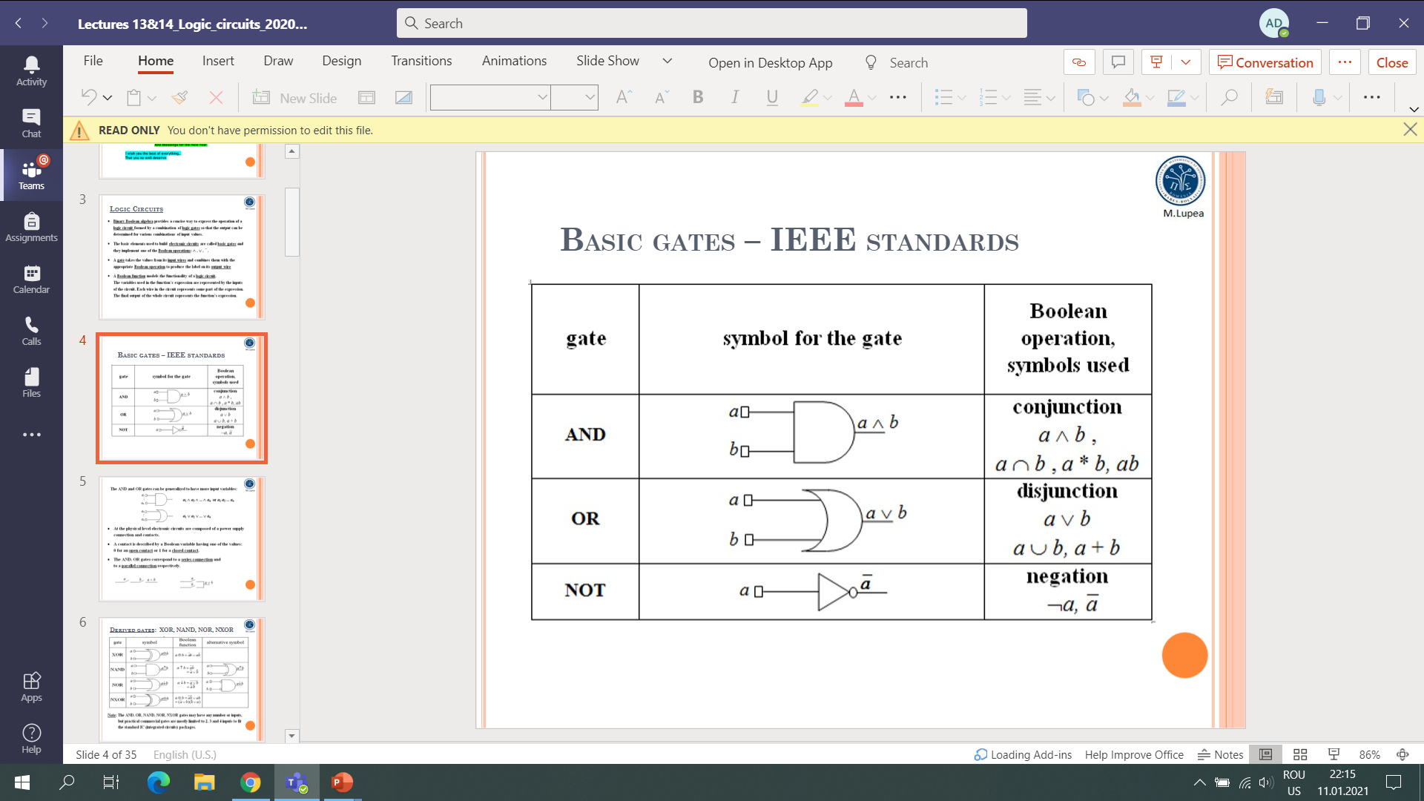
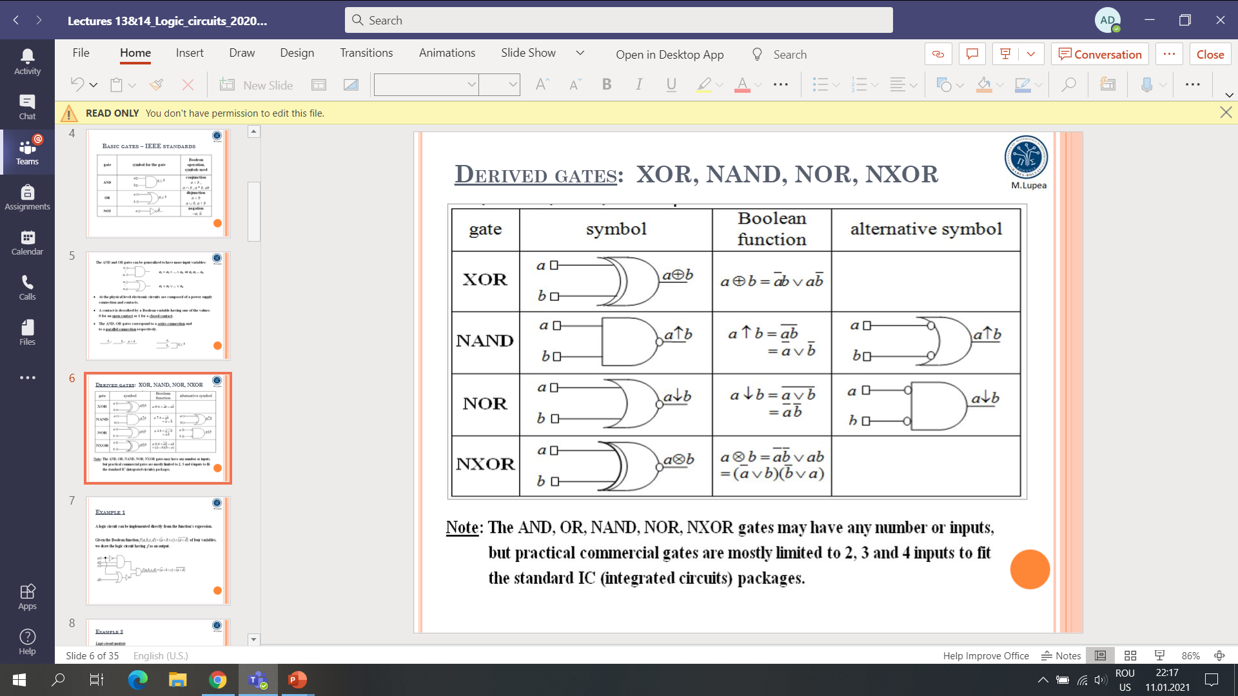
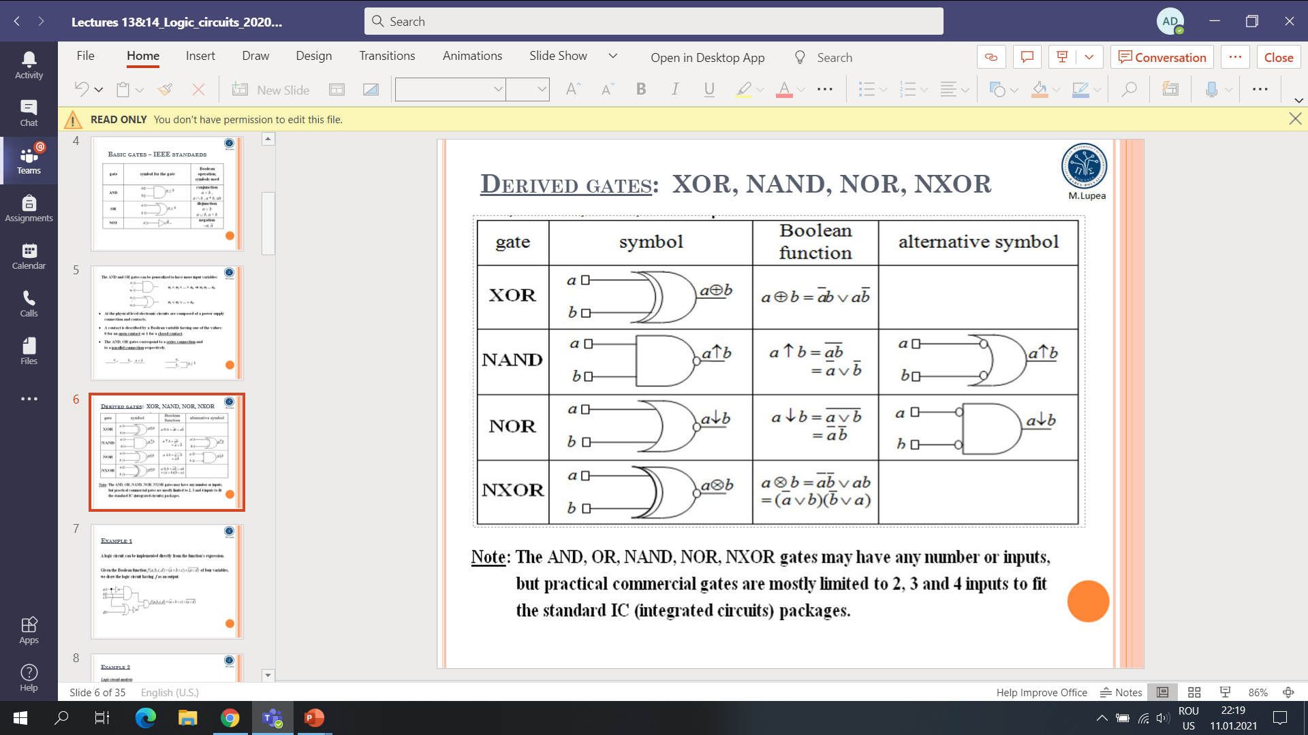
Theoretical result

Slide 4
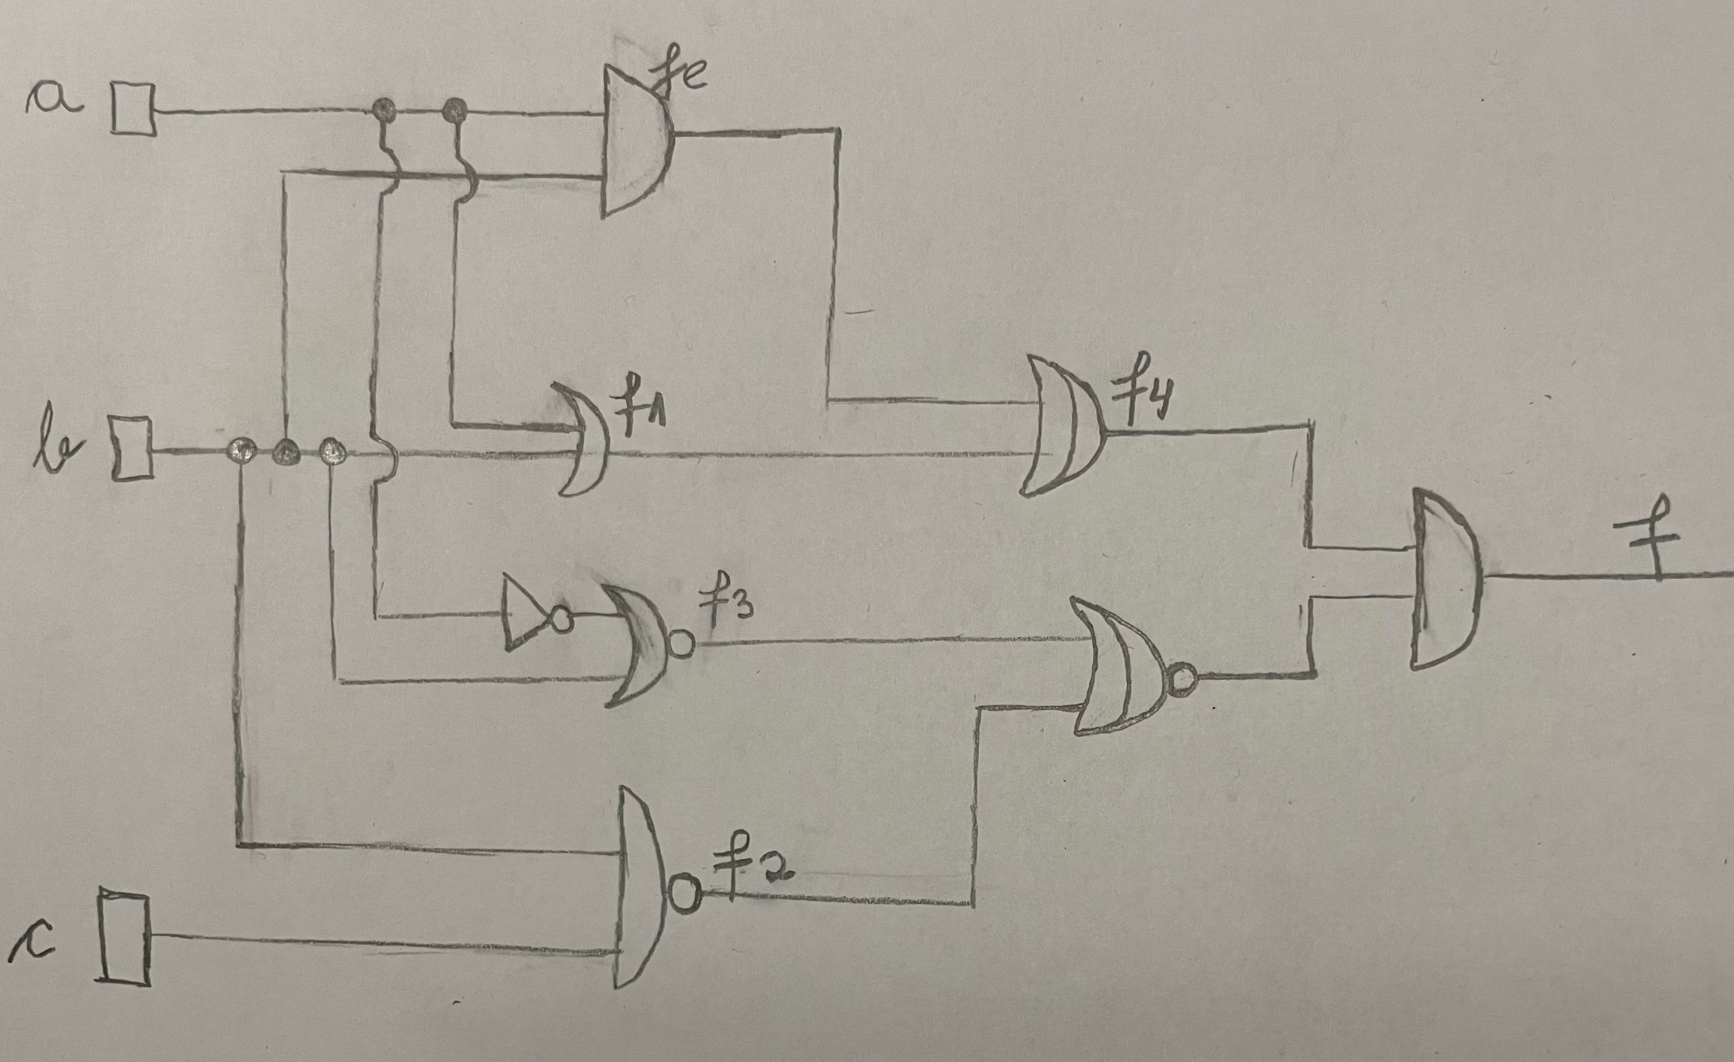
Initial logic circuit

Slide 5
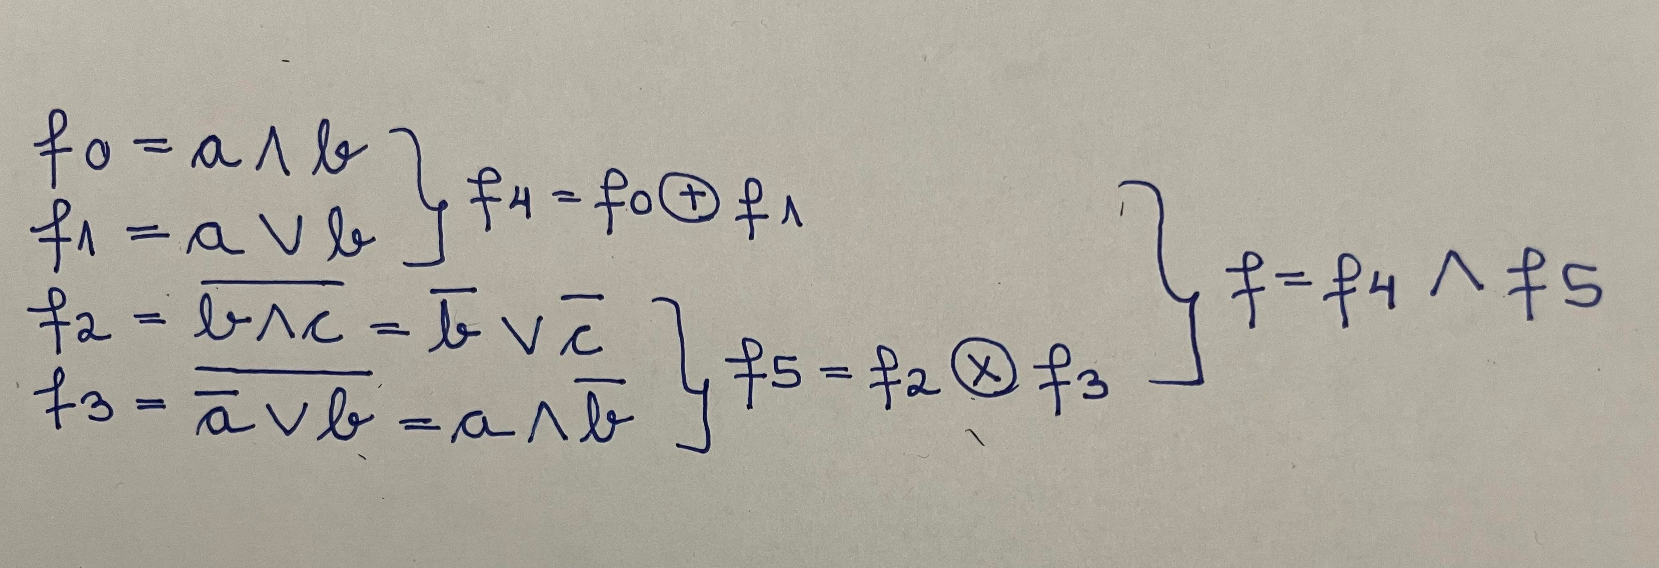
The functions of the initial logic circuit explained

Slide 6
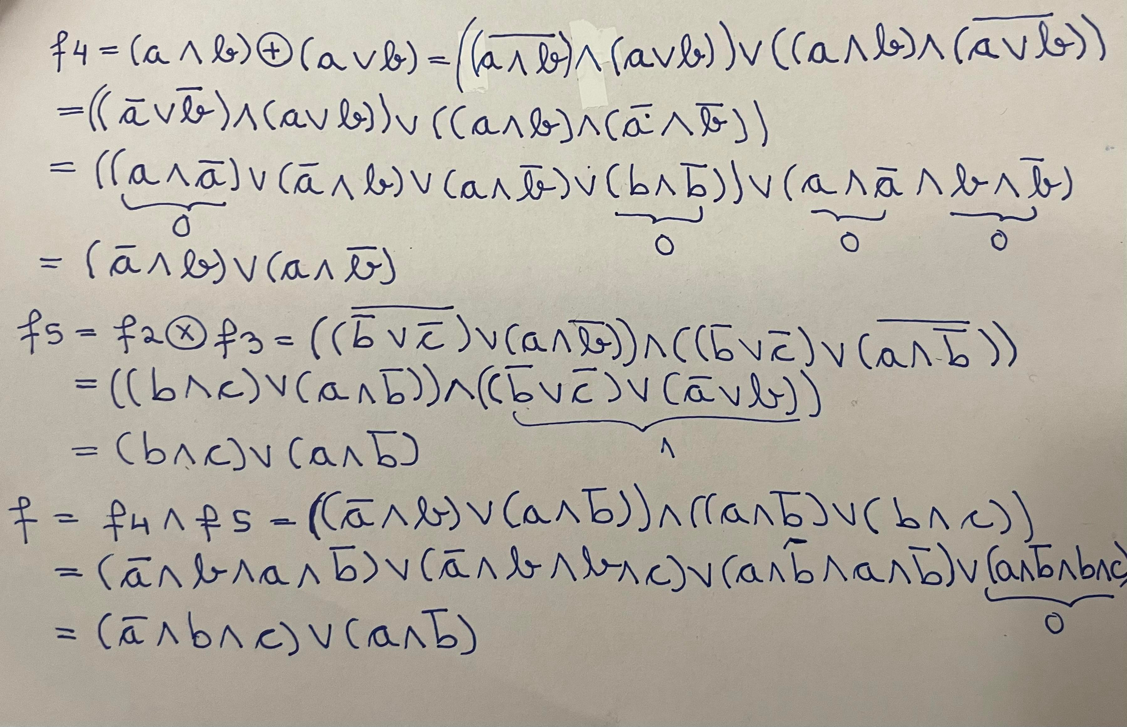
The simplification of the boolean functions

Slide 7
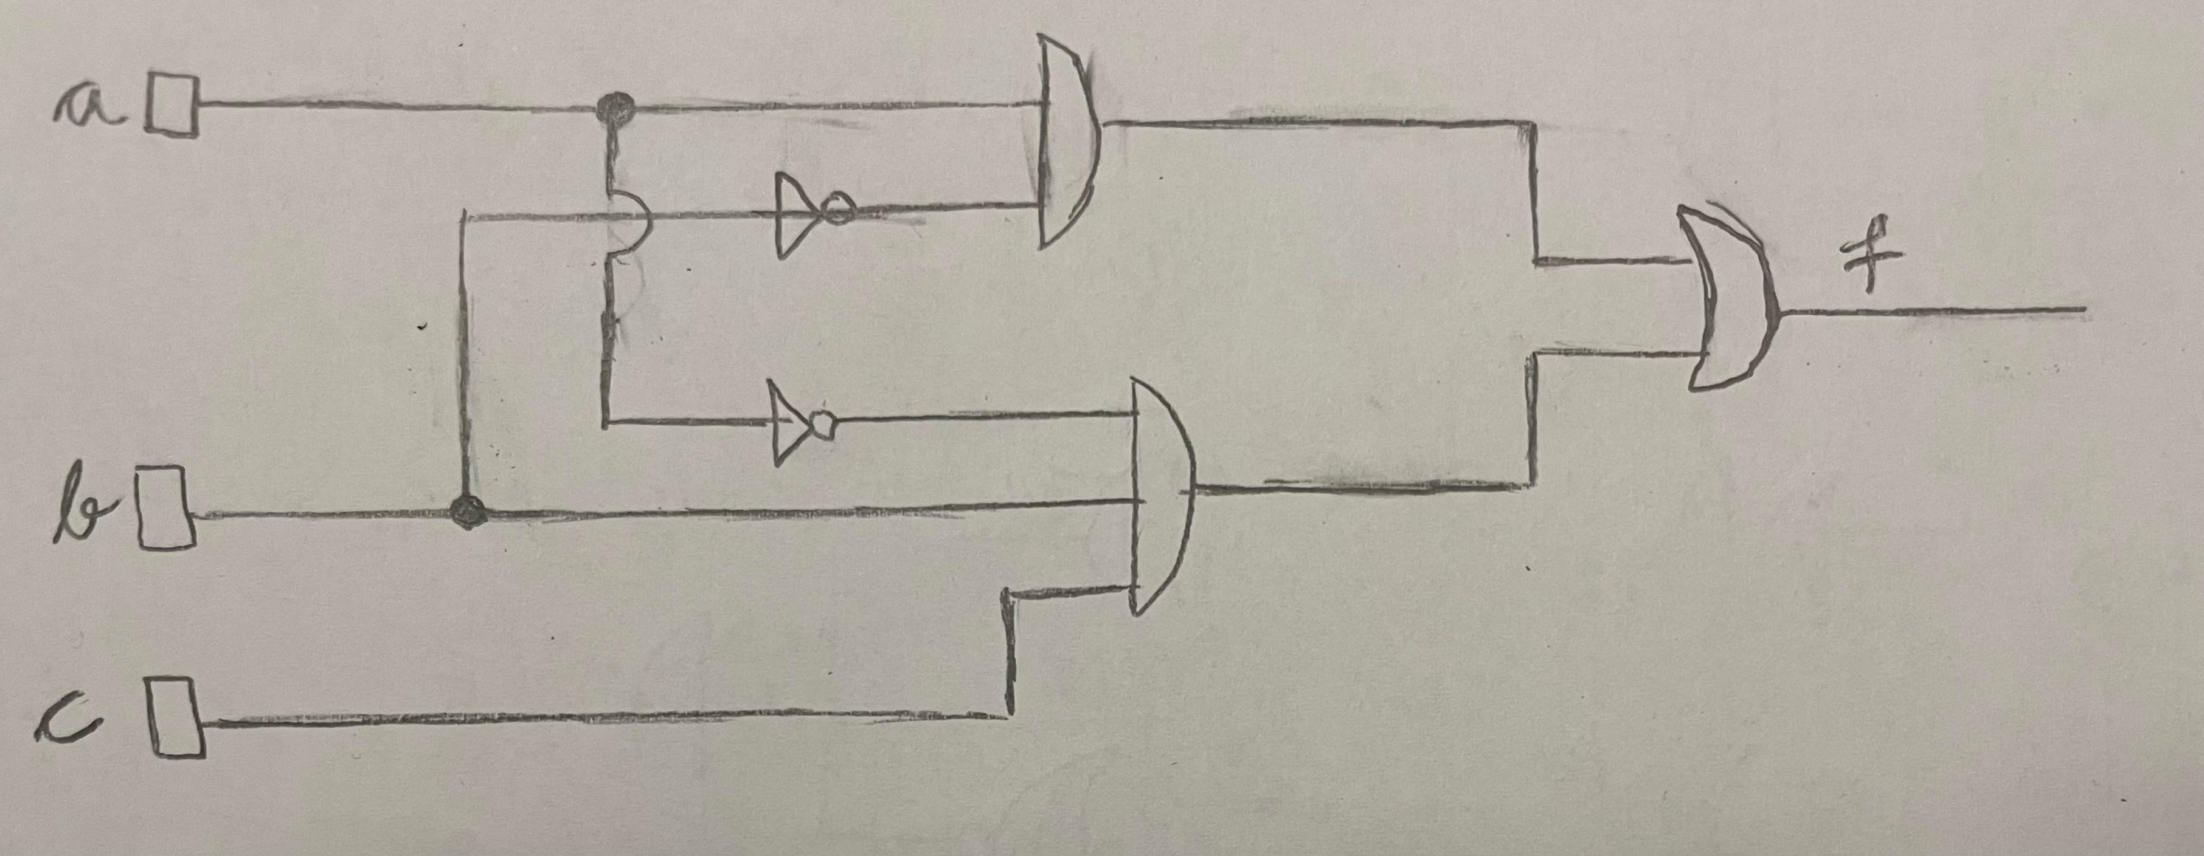
The simplified circuit

Slide 8


Thank you!
Cibu Clara

